Slide 1
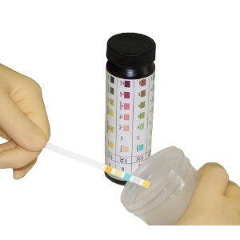
MANUAL DIPSTICK URINALYSIS
Siemens Multistix 10 SG Reagent strips for urinalysis

Slide 2
Manual Dipstick Urinalysis
Bayer Reagent Strips are for professional use in point of care. The strips are intended for use in at-risk patient groups to assist diagnosis in the following areas:
Kidney function
Urinary tract infections
Carbohydrate metabolism
Liver function
The strip also measures physical characteristics, including acid-base balance and urine concentration.

Slide 3
DESCRIPTION
The reagent test areas on Siemens Diagnostics Reagent Strips are ready to use upon removal from the bottle and the entire reagent strip is disposable. The strips may be read visually, requiring no additional laboratory equipment for testing. Certain configurations of strips may also be read instrumentally, using the Clinitek(R) family of Urine Chemistry Analyzers and the appropriate Program Module or Program Card.

Slide 4
Reagent Strips for Urinalysis tests for:
Glucose
Bilirubin
Ketone (Acetoacetic Acid)
Specific Gravity
Blood
pH
Protein
Urobilinogen
Nitrite
Leukocytes

Slide 5
Policy
Manual dipstick testing will be used for screening purposes only.
Only trained nursing and medical staff will perform manual urine dipsticks.
ER will perform the full 10 test analysis.
OPD and Short Stay/OB will perform screening only on glucose, protein, ketones, nitrites, and leukocyte esterase.

Slide 6
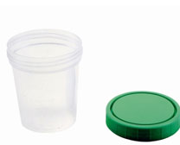
Specimen collection
The specimen collection of choice for analysis is a clean catch collection of the first morning urine specimen.
Random, supra-pubic, catheterized, and midstream specimens are also acceptable for testing.
Urine must be collected in a clean screw cap container.
SPECIMEN PRESERVATION: If the specimen cannot be tested within one hour after collection, it may be refrigerated for up to 24 hours after collection.

Slide 7
Handling of reagent strips
All unused strips must remain in the original bottle.
Do not remove desiccant from the bottle.
Do not remove strip from bottle until immediately before it is to be used for testing. Replace cap immediately and tightly after removing reagent strip.
Do not touch test areas of the reagent strip.
Work areas and specimen containers should be free of detergents and contaminating substances.
Test strips must be stored at room temperature (15-30˚C).

Slide 8
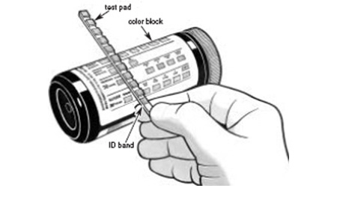
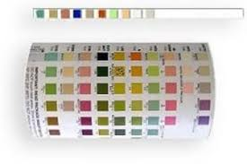
Procedure
(Must be followed exactly to achieve reliable test results)
Mix urine sample well before testing.
Remove one strip from the Multistix 10 SG bottle and recap immediately.
Completely immerse strip in fresh urine and remove the strip immediately to avoid dissolving out reagent.
While removing, run the strip edge against the rim of the urine container to remove excess urine.
Hold the strip in horizontal position to prevent possible mixing of chemicals from adjacent reagent areas.
Visually read test results carefully at the time specified, in a good light (such as fluorescent lighting) and with the test area hold near to the appropriate Color Chart on the bottle label.

Slide 9
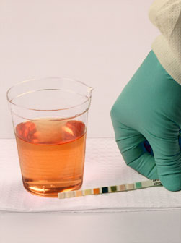
PROPER READ TIME IS CRITICAL FOR OPTIMAL RESULTS:
Glucose and Bilirubin test at 30 seconds after dipping.
Ketone test at 40 seconds.
Specific Gravity test at 45 seconds.
pH, Protein. Urobilinogen, Blood, and Nitrite test at 60 seconds.
Leukocytes test at 2 minutes.
Color change that occur after 2 minutes are of no diagnostic value.
Avoid laying the strip directly on the color chart, as this will result in the urine soiling the chart.

Slide 10
DOCUMENTATION OF RESULTS:
Manual dipstick results must be documented. A functional audit trial must be maintained that allows retrieval of results.
All results must be recorded on the patient test log.
Document date test was performed.
Record patient initials, medical record number, and sign/symptom.
The initials of the point of care testing personnel performing patient testing must be documented on log.
Results must be entered into EHR or RPMS.

Slide 11
QUALITY CONTROL:
The performance of the reagent strips MUST be confirmed by testing with Negative and Positive QC material whenever a new bottle is first opened.
Thereafter, quality control must be performed weekly.
Water should NOT be used as a Negative control.
A designated nursing staff will perform required QC. QC results will be documented on the QC log.

